Slide 1

Fallon Health
Medical Pharmacy
Prior Authorization Program
Presented by Lisa Corbett
senior provider relations manager, Magellan RX Management

Slide 2
Agenda
1
Program Overview
2
Review Process
3
Magellan Rx Website
4
Resources

Slide 3
Program Overview

Slide 4

Effective January 1, 2020, Fallon Health will be implementing a change in how certain drugs that fall under the medical benefit are managed.
This new program will be administered by Magellan Rx Management (Magellan Rx). Magellan Rx will be responsible for reviewing and approving these drugs.
Beginning January 1, 2020, providers may begin contacting Magellan Rx to obtain prior authorizations for members who will receive treatment/drugs within the scope of this program on or after January 1, 2020.

Slide 5

Places of Service
Prior authorization is required by Magellan Rx when the drugs are administered by practitioners in the following places of service (POS):
  Physician Office (POS 11)
  Patient Homes (POS 12)
  Outpatient Facilities (POS 19, 22)

Slide 6
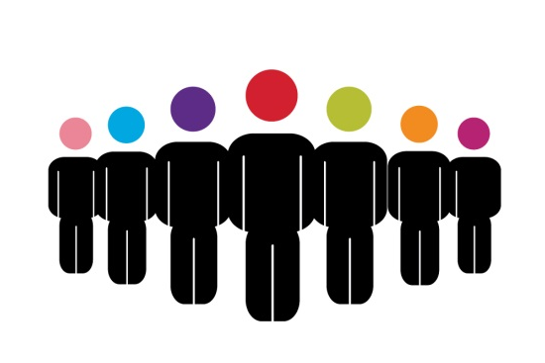
Impacted Members
The program will apply to members enrolled in the following plans:
Commercial
  Direct Care
  Select Care
  Fallon Preferred Care
  Community Care
  Steward Community Care
Medicare
  Fallon Medicare Plus™ (formerly Fallon Senior Plan™)
  Fallon Medicare Plus Central
Medicaid
  Fallon 365 Care
  Berkshire Fallon Health Collaborative
  Wellforce Care Plan
NaviCare®
Summit ElderCare® (PACE)

Slide 7
Transition of Care Process
Date of Service
Authorizations issued by Fallon Health for dates of service before January 1, 2020, for the medications identified as part of this program will be effective until the authorization end date.
Validity Date
To continue treatment after the original authorization validity date, you must obtain an authorization from Magellan Rx prior to the expiration date.
End Date
Claims for dates of services after the authorized end date will be denied if the provider has not obtained a successive authorization from Magellan Rx.

Slide 8
Drugs Managed Through Magellan Rx
For the lists of drugs managed by Magellan Rx Management for Fallon Health Members, please refer to the lists of drugs* posted on the Fallon Health website at the following links:
For a comprehensive PDF list of in scope drugs:
http://fchp.org/providers/announcements.aspx
Under Pharmacy Updates
Prior Authorization Drugs:
http://www.fchp.org/providers/pharmacy/online-drug-formulary.aspx
Select Medical Benefit Formulary from the dropdown, then select Go
Post Service Claim Edit Policies:
http://fchp.org/en/providers/criteria-policies-guidelines/payment-policies.aspx
Under Drugs and biologicals payment policy
You may also call the Provider Services at 866-275-3247 prompt 5.
*The list of medical drugs requiring prior approval is subject to change.

Slide 9
Biosimilars
For your Commercial and Medicaid patients, Fallon will be focusing on preferred biosimilar therapies when appropriate.
Effective January 1, 2020, for your patients new to therapy, Fallon’s preferred biosimilars will be:
  Preferred Non-preferred
  Zarxio Neupogen
  Retacrit Procrit/Epogen
  Rituximab biosimilar Rituxan
  Mvasi Avastin
  Kanjinti Herceptin
  Udenyca
  Neulasta
Inflectra will be the preferred therapy for all patients currently receiving Remicade and any patients new to therapy. Remicade coverage will require failure of both Inflectra and Renflexis. Medical criteria updates will be posted on the Fallon website. Medicare and Navicare plans are excluded from this requirement.

Slide 10
Review Process

Slide 11

Provider Responsibilities
Responsible for obtaining the prior authorization before services are provided.
Responsible for ensuring that the authorization was obtained prior to services being rendered.

Slide 12
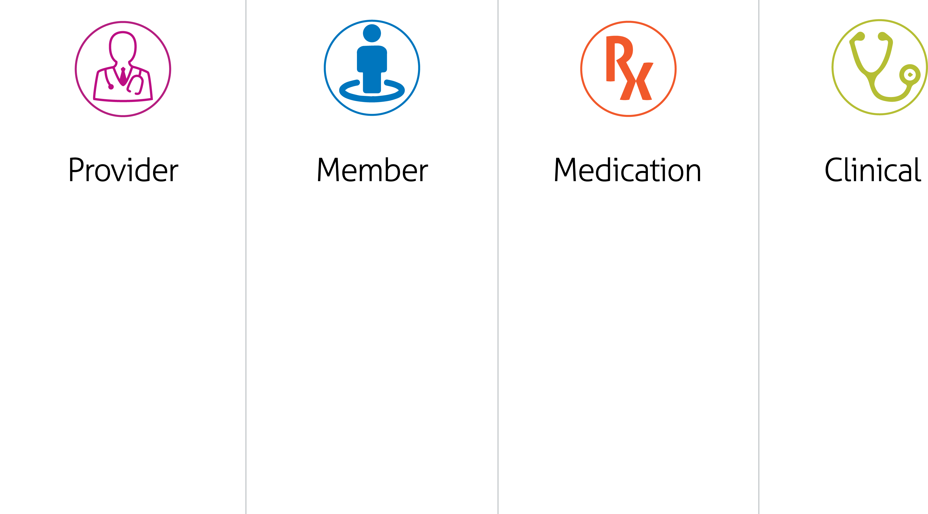
Information Needed
Ordering Provider
Name
Tax ID
Address
Office Telephone
Number
(Same information is needed for Rendering Provider if different
from Ordering Provider)
Member Name
Date of Birth
ID Number
Height
Weight
Diagnosis Code
Place of Service Code
Requested Drug Name
or HCPCS Code
Dosage
Frequency
Anticipated Start Date
of Treatment
Clinical notes
Pathology Reports
Relevant Test Results
If additional information is requested by Magellan Rx, the practitioner should be prepared to upload documents on the provider portal or to fax documents to Magellan Rx HIPAA compliant fax.

Slide 13
Timeframes
Line of Business | Routine Requests | Urgent/Expedited
Commercial | <2 Business Days | <2 Business Days
Medicare | <72 Hours | <24 Hours
Medicaid | <24 Hours | <24 Hours
The timeframes above are based on the receipt of all necessary information.
Most requests can be approved upon initial outreach to Magellan if all of the necessary information is provided.

Slide 14
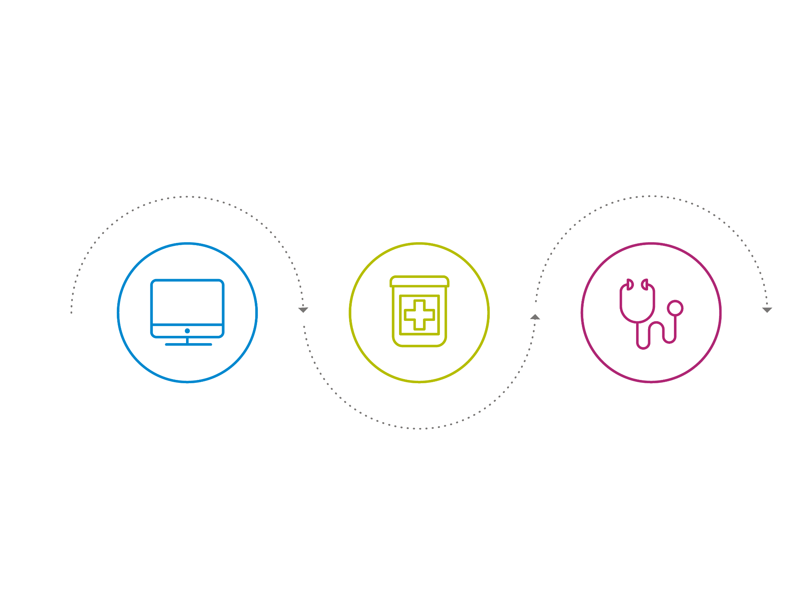
Determination Process Flow
PHARMACIST REVIEW
If additional detail is needed, the case is routed to an MRx pharmacist who will outreach to the requesting provider.
INTAKE
In most cases, approvals can be made based on initial information provided by the requestor.
PHYSICIAN REVIEW
The case may be escalated to an MRx physician, who will discuss case with the ordering provider.
Notes:
In most cases, approvals can be made based on the initial information provided by the requestor directly through the Magellan Rx website.
If there is a question or concern regarding the information provided, the case will be sent to a pharmacist who will reach out to the requesting provider.
If the pharmacist cannot reach an agreement regarding the appropriate course of treatment with respect to the requested medication, the case will be escalated to an Magellan Rx physician.
The Magellan Rx physician will discuss the case with the provider and they will make a mutual decision, in accordance with the plan guidelines, on an appropriate course of action.

Slide 15
Magellan Rx Website

Slide 16

Obtaining an Online Account
Providers directly contracted with Fallon may create an online account for Prior Authorizations:
Visit our self-service provider portal at ih.MagellanRx.com
Click on New Access Request-Provider under Quick Links
Click on Contact Us to register

Slide 17
Resources

Slide 18

Prior Authorization Resources
For routine requests and clinical guideline information, visit ih.magellanrx.com
For urgent or expedited requests call Magellan Rx at 800-424-1740.
Magellan Rx Management has staff available 24 hours per day for urgent requests by phone (including after hours, weekends and holidays).
If you have claim, benefits, and/or eligibility questions, please call Fallon Health at 866-275-3247 or email askfchp@fallonhealth.org .
Fallon Health Payment Policy: http://www.fchp.org/providers/criteria-policies-guidelines/payment-policies.aspx

Slide 19
Thank you for attending today!
Lisa J. Corbett
Senior Provider Relations Manager
Magellan Rx Management ljcorbett@magellanhealth.com
978-412-2332
The information presented in this presentation is confidential and expected to be used solely in support of the delivery of services to Magellan Rx Management Health Plan Client members. By receipt of this presentation, each recipient agrees that the information contained herein will be kept confidential and that the information will not be photocopied, reproduced, or distributed to or disclosed to others at any time without the prior written consent of Magellan Health, Inc.

